Slide 1
Student Course Registration System
Problem: Manual registration leads to errors and duplicate entries
Target Users: Students and basic academic administrators

Slide 2
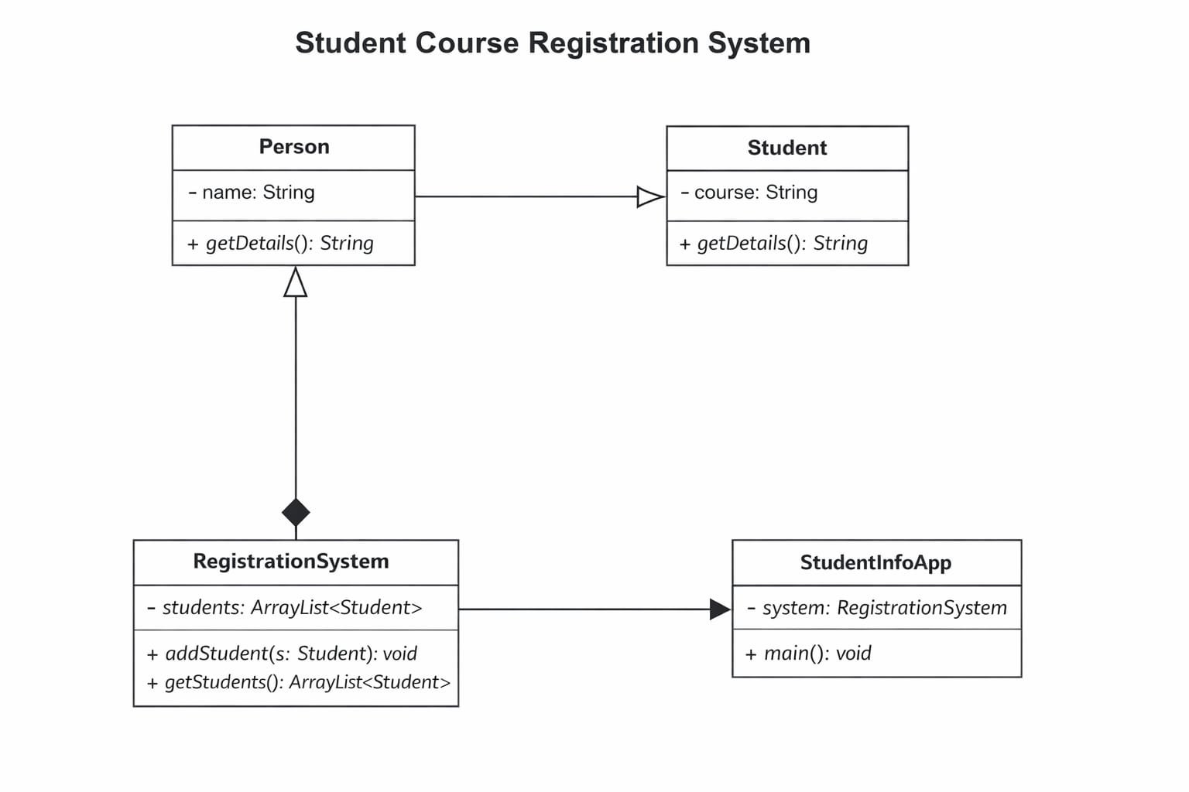
System Design
Architecture: GUI → RegistrationSystem → Student → Person
Key Classes:
• Person: Base class (name)
• Student: Adds course details
• RegistrationSystem: Manages data
• StudentInfoApp: GUI handling
Package Structure:
src/ → Person, Student, RegistrationSystem, StudentInfoApp

Slide 3
OOP Concepts Used
Abstraction: RegistrationSystem handles backend logic
Inheritance: Student extends Person
Polymorphism: getDetails() method overridden
Encapsulation: Private variables with controlled access
Design Pattern: Simple layered structure (GUI + logic separation)

Slide 4
Technical Highlight
Validation and Duplicate Entry Handling
Prevents empty input using validation checks
Prevents duplicate registrations using comparison logic
Chosen to improve reliability and data integrity

Slide 5
Live Demo
The application allows users to register a student by entering a name and selecting a course. Once submitted, the system dynamically displays all registered students.
The system ensures data integrity by validating user input. If the name field is left empty, an error message is displayed to prevent invalid entries.
Additionally, the system prevents duplicate registrations by checking if the same student is already registered for a selected course.

